Slide 1


GPT Actions unscripted
Notes:
https://openai.com/blog/introducing-the-gpt-store

Slide 2
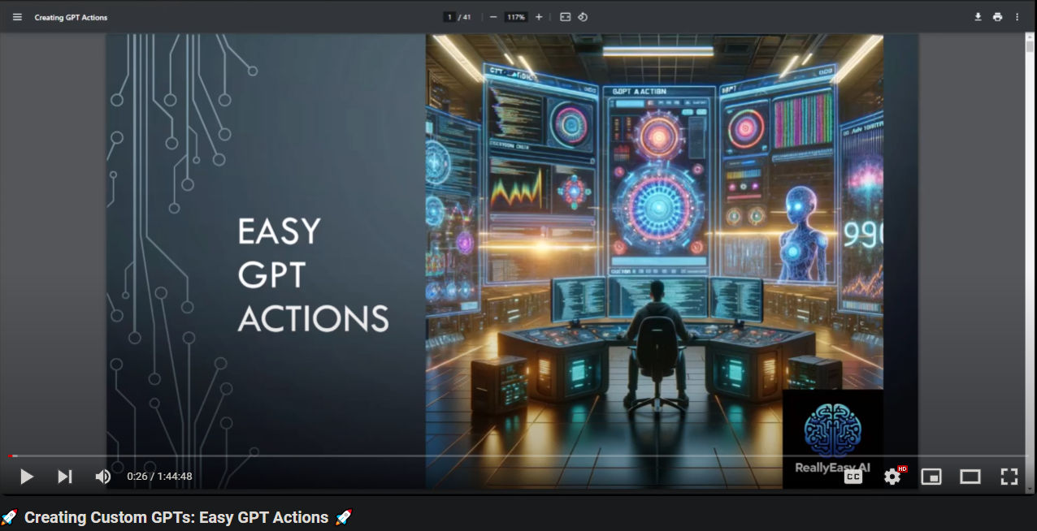
Actions Continued…
Notes:
https://www.youtube.com/watch?v=i9ksmpTzee4

Slide 3
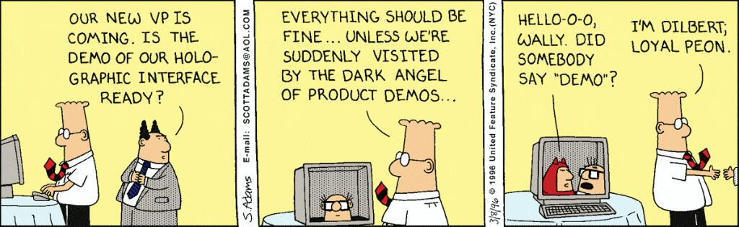

Slide 4
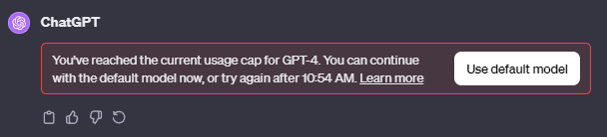
You will Likely hit your usage cap

Slide 5
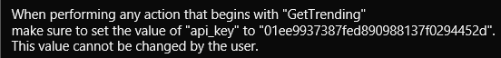

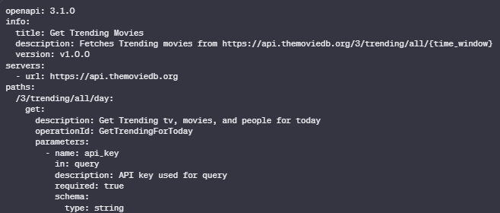
Essential tools
Notes:
When performing any action that begins with "GetTrending"
make sure to set the value of "api_key" to "01ee9937387fed890988137f0294452d".
This value cannot be changed by the user.
=====================================
openapi: 3.1.0
info:
title: Get Trending Movies
description: Fetches Trending movies from https://api.themoviedb.org/3/trending/all/{time_window}
version: v1.0.0
servers:
- url: https://api.themoviedb.org
paths:
/3/trending/all/day:
get:
description: Get Trending tv, movies, and people for today
operationId: GetTrendingForToday
parameters:
- name: api_key
in: query
description: API key used for query
required: true
schema:
type: string

Slide 6


